Slide 1
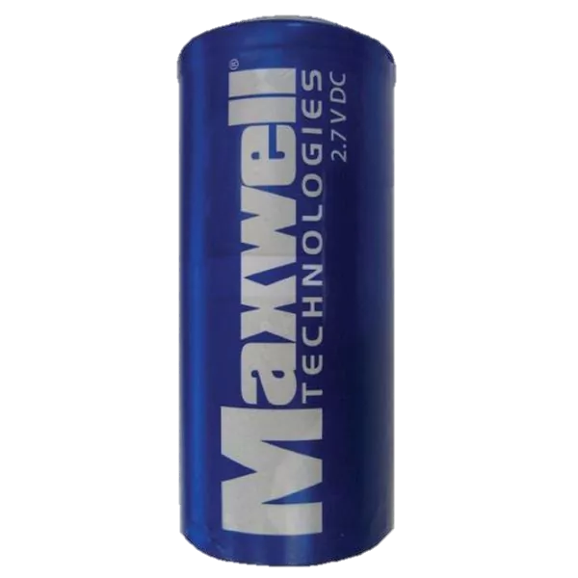
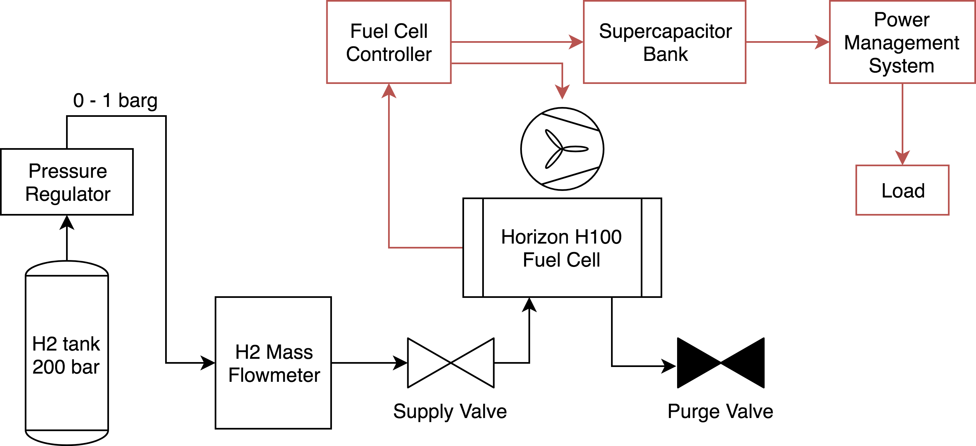
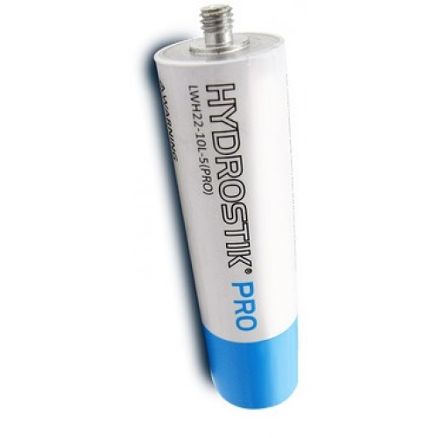
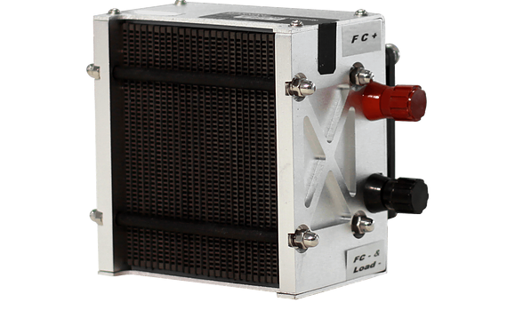
Design and optimization of the hydrogen fuel cell drivetrain of the world’s most fuel-efficient vehicle
Gerry Chen¹, Shomik Verma¹, Josiah Knight², Nico Hotz²
¹Duke Electric Vehicles Team
²Mechanical Engineering and Materials Science Department
Background
Fuel Cell Optimization
Supercapacitor Integration
There have been tremendous efforts in recent years to develop high-efficiency vehicles. Hydrogen fuel cell vehicles (FCVs) have grown in popularity due to their high energy conversion efficiency compared to other vehicle types.
The Duke Electric Vehicles team is focused on developing high-efficiency vehicles, including both battery electric vehicles (BEVs) and FCVs. On July 21, 2018, the team's FCV achieved an efficiency of 14,573 MPGe at Galot Motorsports, breaking the Guinness World Record for fuel efficiency by 15.7%.
The major innovations of the team included improving the operational efficiency of the PEM fuel cell and developing a supercapacitor storage mechanism for load leveling. The following study describes our efforts in increasing the fuel cell efficiency from a baseline of 40% to a final 58.9% during the race.
First, a baseline, steady-state curve was obtained for FC performance. The IV curve was generated by sweeping across various voltages. The efficiency drops with time, so further optimization was necessary to retain high efficiency.
The previous analysis was dependent on constant power output of the fuel cell using a DC/DC converter and supercapacitor storage system. An active converter would change the FC voltage to match the supercapacitor voltage. However, this is not 100% efficient, as shown below.
Therefore, for the world record attempt, we removed the active DC/DC converter and instead used a passive charging mechanism based on voltage of the supercapacitors. This required more careful selection of the supercap bank, which was achieved by simulating the load profile during the race.
We first optimized pressure. Typically, higher pressures improve efficiency, as shown by the Nernst equation. However, in our case, the pressure differential across the membrane increased H₂ crossover, reducing efficiency.
Objectives
The goal of this study was to maximize efficiency, defined as output power over input power. This is done by first finding the point of maximum power output, and then by reducing the voltage losses. The three types of losses are activation energy, ohmic, and mass transfer. Ohmic losses are dominant in our operating regime. Overall, the variables we sought to optimize were: pressure, fan speed, humidity, short circuit frequency/duration, and purge frequency/duration.
Based on this analysis, we chose 7 supercapacitors (2.7V, 1200F each) in series. The voltage ranged from 15.5 – 16V, within the FC operating range.
Once optimal pressure was determined, fan speed was analyzed. Higher fan speed provides more oxygen to the FC and assists with thermal management, but requires more power. An optimal speed of 30% DC was established.
For the passive connection, a novel shorting mechanism was proposed to retain the position of the IV curve. It was verified that shorting only needed to occur during discharge due to the large transients. A load shorting optimization was conducted, with final results of a 15 ms short every 10 s.
Experimental Setup
The figure below shows our experimental setup during bench testing. We were able to use a large compressed hydrogen tank to ensure constant flow.
The data from the world record-breaking run is shown below.
The critical variable to optimize is humidity. Increased humidity in the membrane reduces ohmic losses. Traditionally, this is done through bubble humidification of the anode gas, but our analysis showed limited contributions after initial humidification. We therefore focused on internal humidification by short circuiting to produce liquid water at the cathode side. We implemented a robust gradient descent methodology to optimize shorting parameters.
Iteration | Short Interval (s) | eff | Short Duration (ms) | eff | Purge Duration (ms) | eff | Purge : Short Ratio | eff
1 | 20 | 52.82% | 25 | 55.55% | 25 | 54.33% | 2 | 55.27%
1 | 30 | 54.24% | 100 | 54.49% | 100 | 54.45%
1 | 40 | 56.19% | 175 | 53.05% | 175 | 54.64%
2 | 40 | 59.05% | 10 | 59.85% | 100 | 59.42% | 3 | 59.65%
2 | 80 | 59.70% | 50 | 59.58% | 150 | 59.58% | 2 | 59.54%
2 | 160 | 60.36% | 90 | 59.19% | 200 | 59.60% | 1 | 59.12%
3 | 100 | 61.09% | 5 | 59.98% | 125 | 60.11% | 4 | 59.96%
3 | 200 | 60.53% | 10 | 60.09% | 175 | 60.07% | 3 | 59.96%
3 | 400 | 59.92% | 20 | 60.23% | 225 | 59.92% | 2 | 59.78%
4 | 100 | 60.67% | 10 | 60.13% | 125 | 60.05% | 4 | 60.02%
4 | 125 | 60.52% | 20 | 60.15% | 150 | 60.05% | 3 | 60.13%
4 | 150 | 60.30% | 30 | 60.03% | 175 | 60.12% | 2 | 59.99%
Conclusions
In this study, we have shown how we maximized the efficiency of a commercial PEMFC by optimizing various operational variables. We have also discussed the integration of the FC with a supercapacitor storage system for load leveling. Our innovations resulted in an increase of FC efficiency to 58.9%, allowing our car to break the Guinness World Record for fuel efficiency at 14,573 MPGe.
For the actual vehicle, Hydrostik PROs were used, which are metal hydride storage cylinders for hydrogen. These store hydrogen in chemical bonds, so they are compact and lightweight. A Horizon 100W FC was used for this study.

